Slide 1

Editorial
Welcome to join our journey for the beauty around us. From north to south, our steps have covered a large scale in our homeland. In this magazine, you will see Lu Yunlong’s travel blog of his trip to Xi’an and Dong Chengcheng’s funny story with a small creature when visiting the West Lake. And there is also a photograph with the best scenery in Li Han’s eyes. Last but not least, Wang Jiashun will provide us with a brief introduction of the Great Wall, one of the greatest historic wonders in the world.

Slide 2
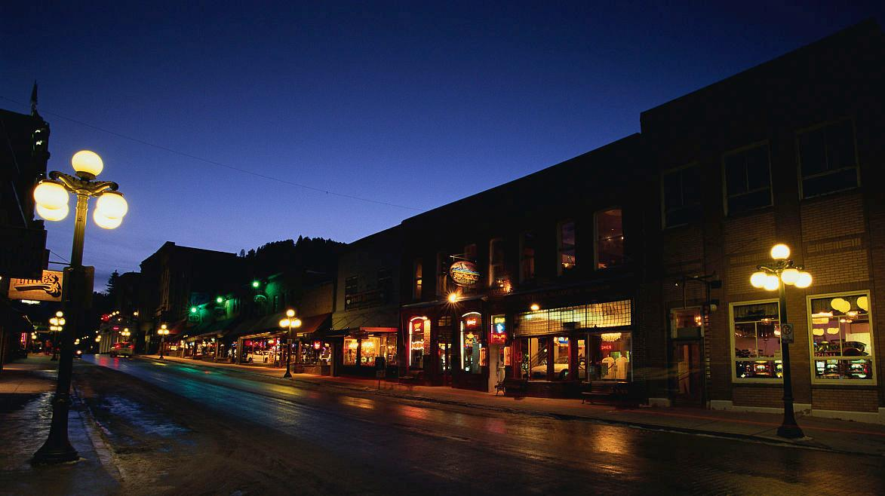
My Trip Blog
— Xi’an
—Group 4

Slide 3
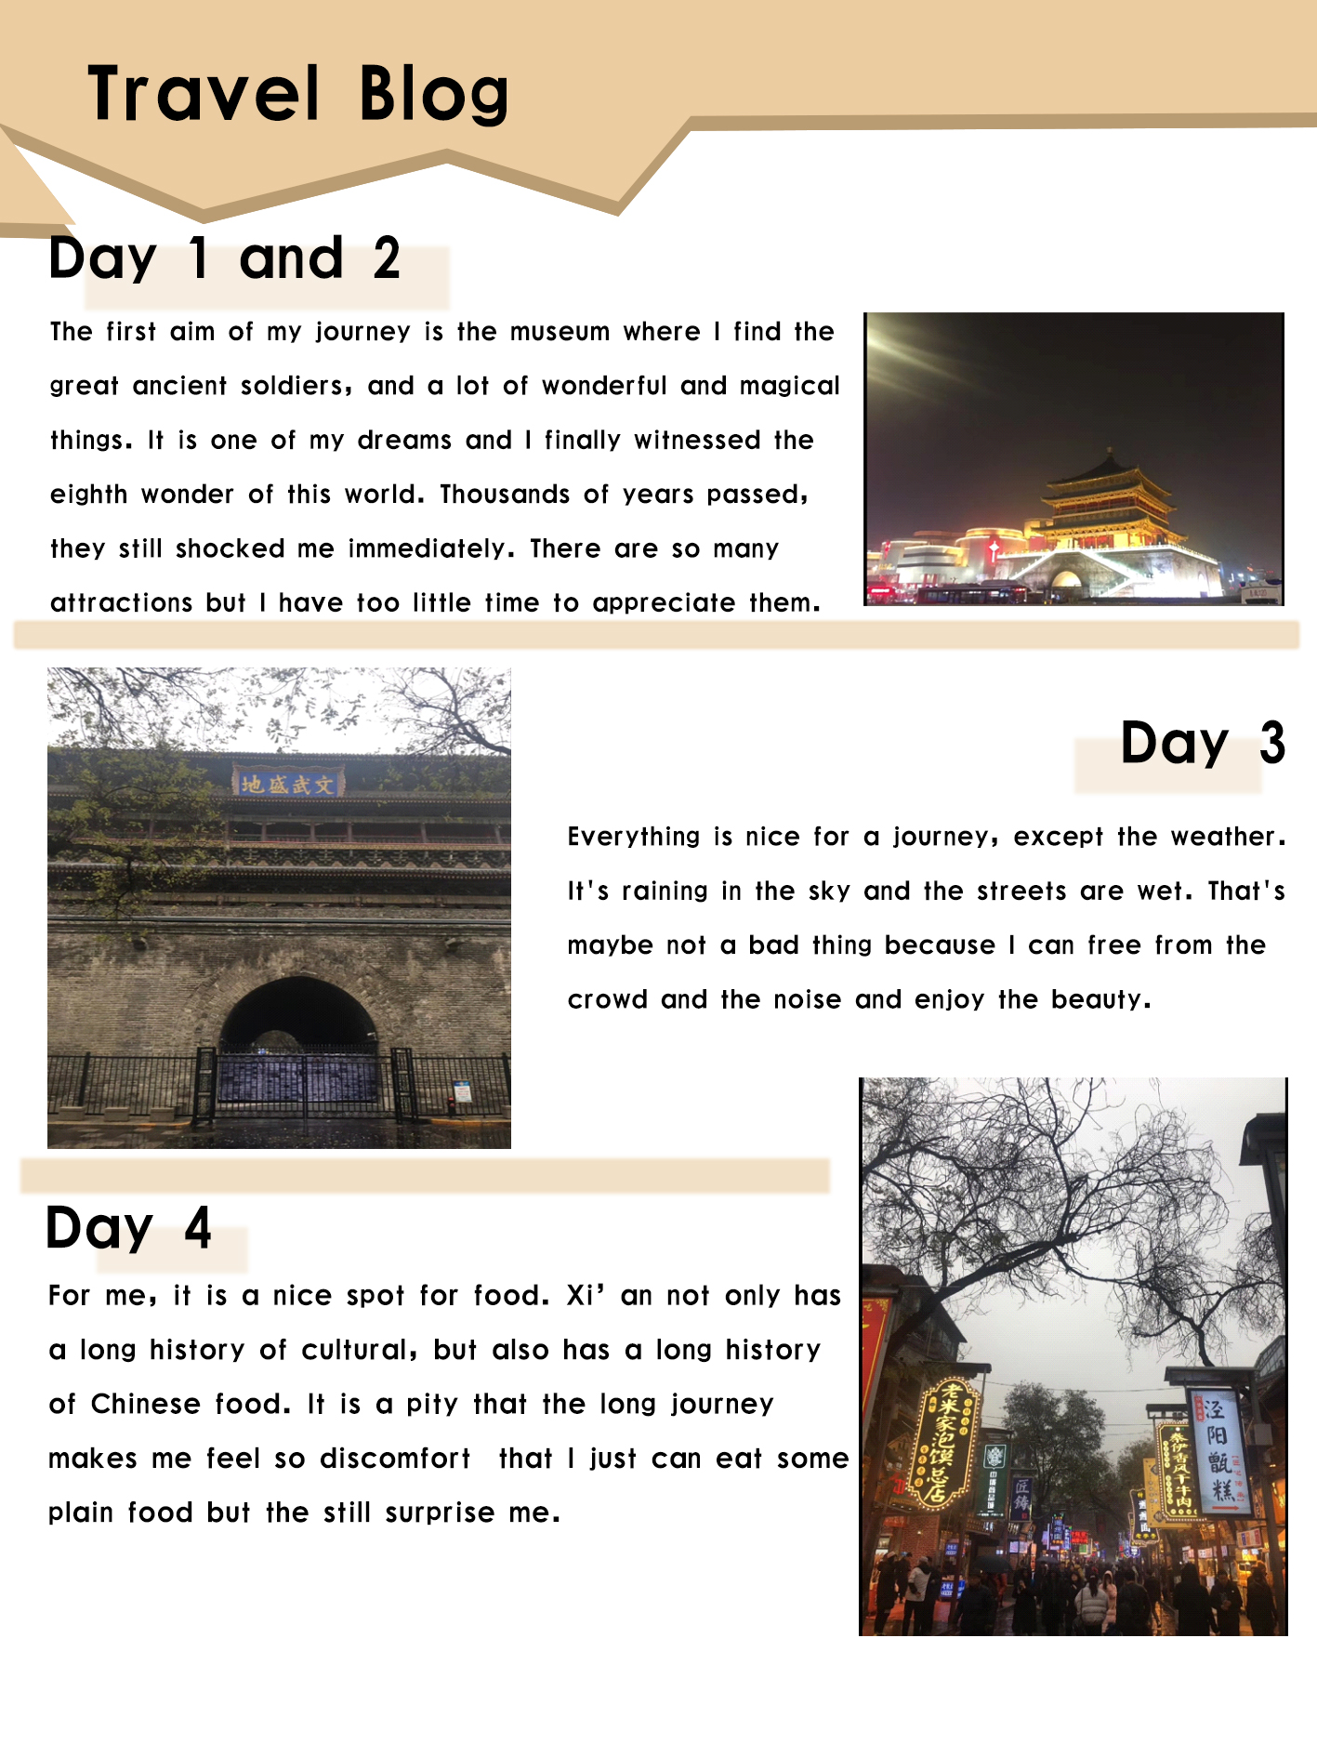
My Magzine Page

Slide 4
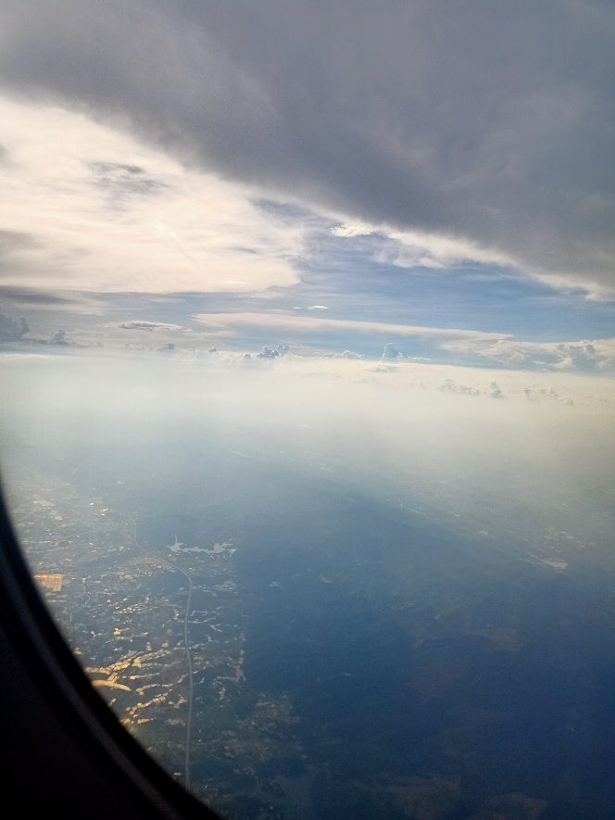
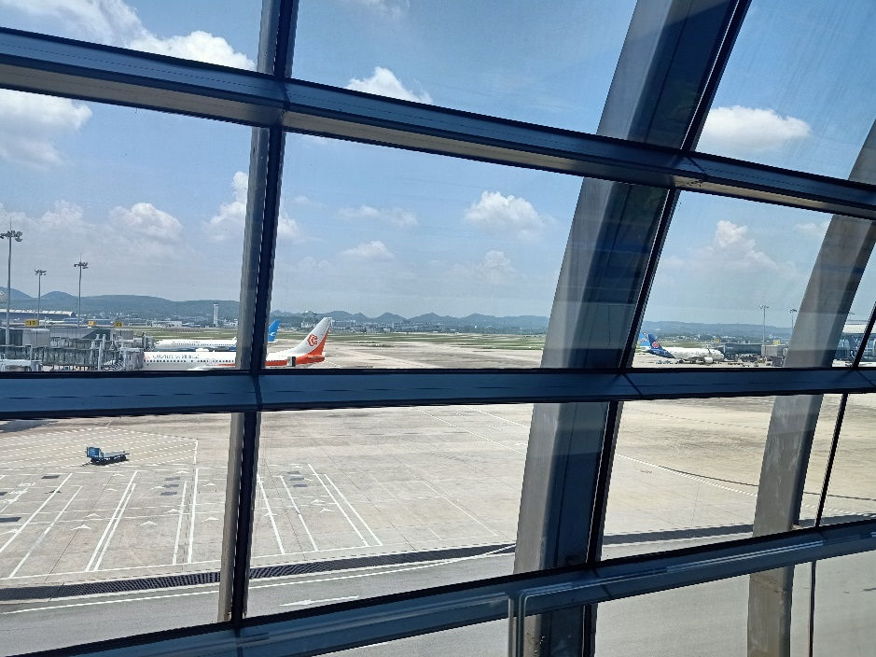
Before
Xi'an is the capital of Shanxi province and one of the most important historic cities in China. What’s more, it has been the capital of 13 dynasties. A five-days travel will let me find its beauty and I know the city which has more than 3,100 years of history won’t let me down.

Slide 5
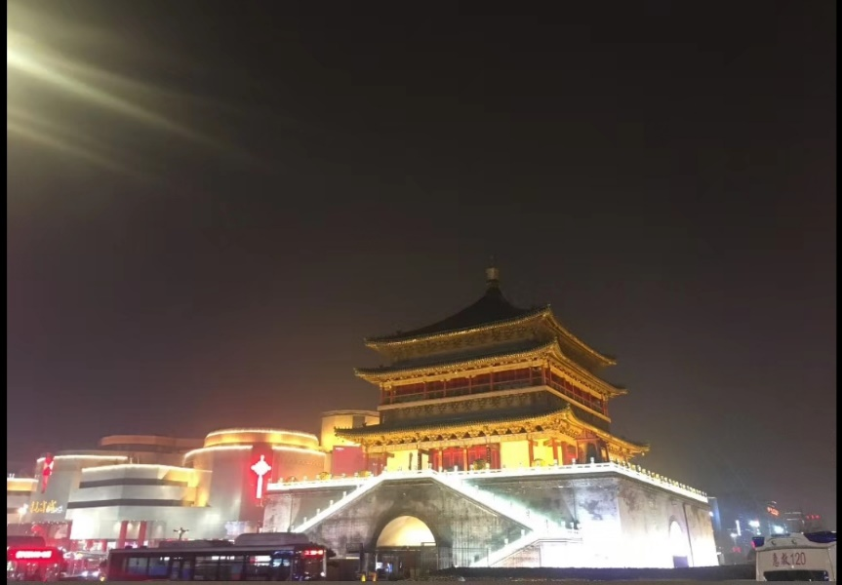
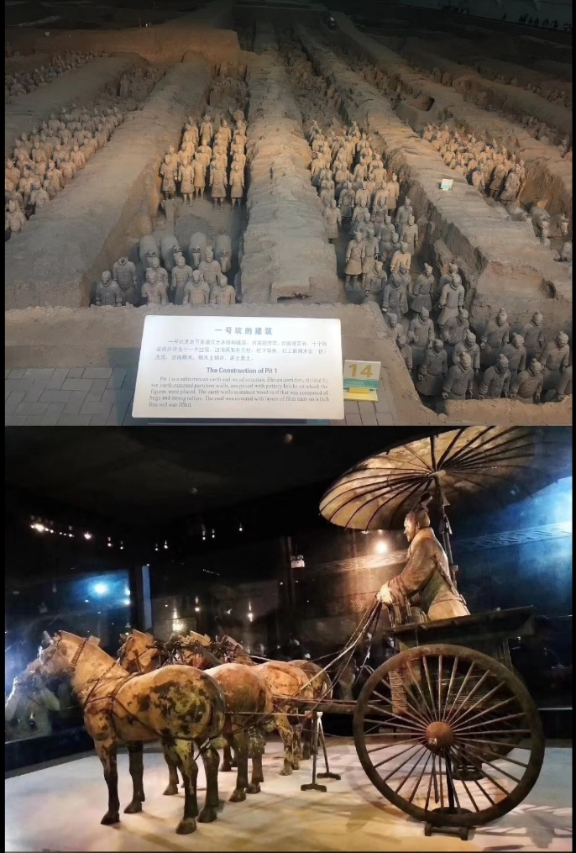
Day 1 & 2
The first aim of my journey is the museum where I find the great ancient soldiers, and a lot of wonderful and magical things. It is one of my dreams and I finally witnessed the eighth wonder of this world. Thousands of years passed, they still shocked me immediately. There are so many attractions but I have too little time to appreciate them.

Slide 6
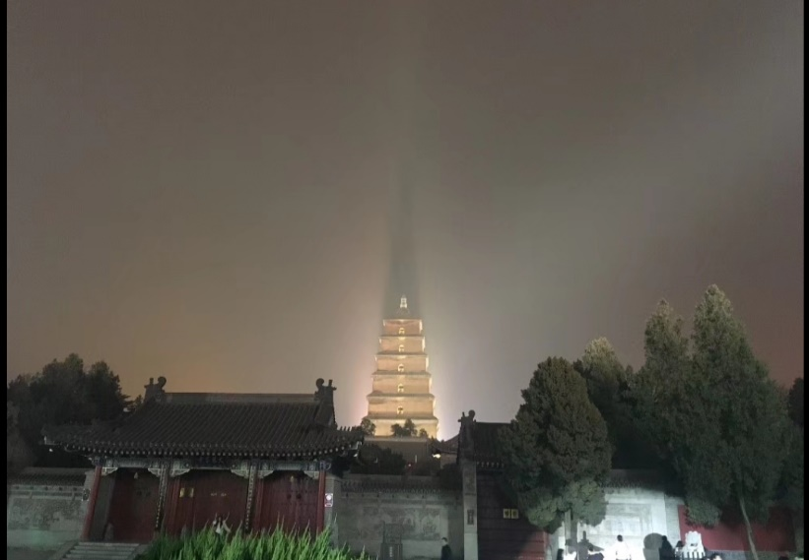
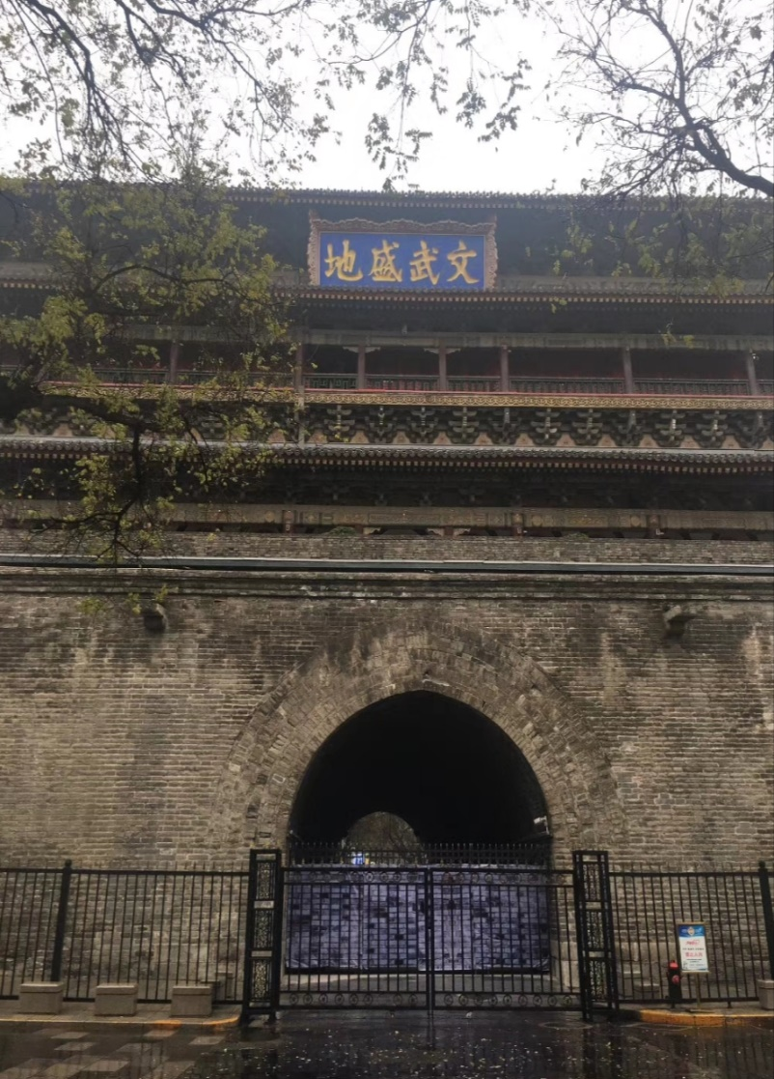
Day 3
Everything is nice for a journey, except the weather. It's raining in the sky and the streets are wet. That's maybe not a bad thing because I can free from the crowd and the noise and enjoy the beauty.

Slide 7
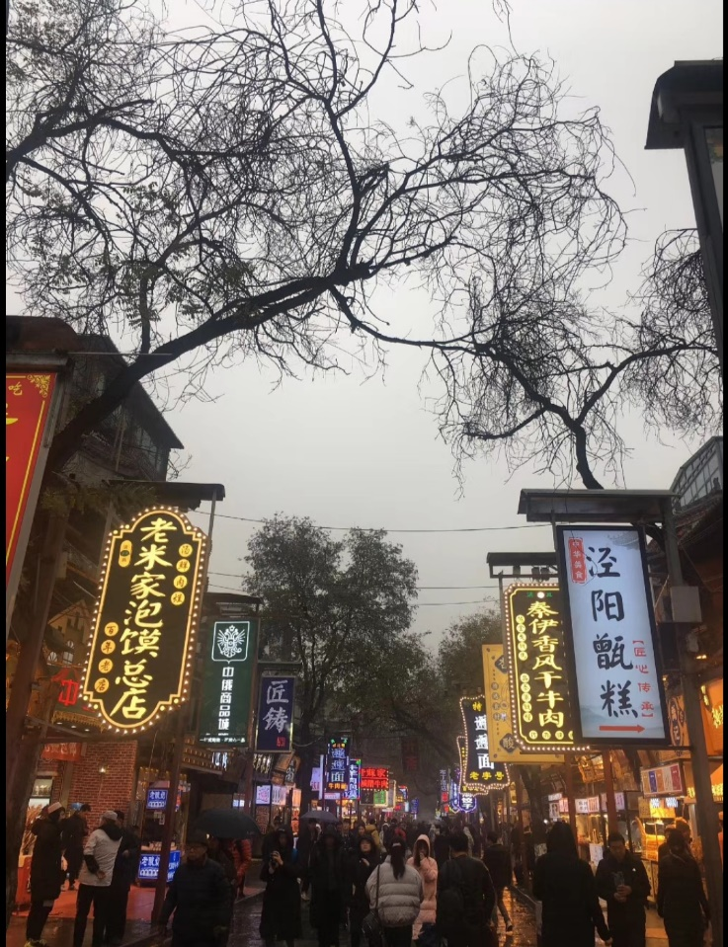
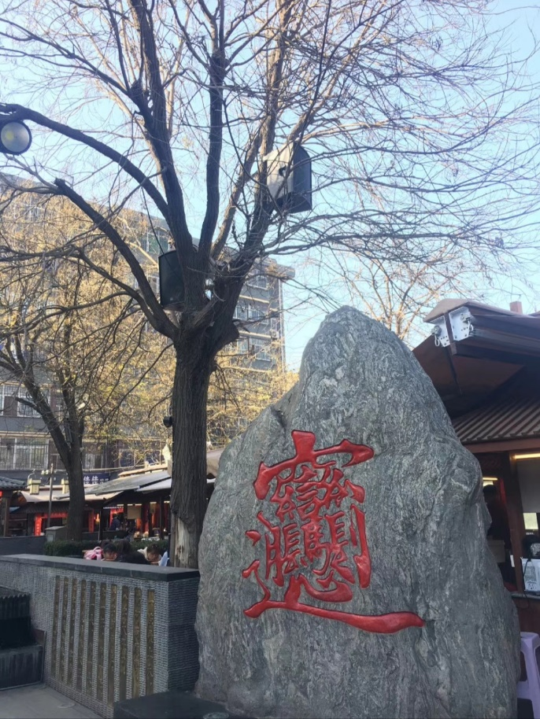
Day 4
For me, it is a nice spot for food. Xi’an not only has a long history of cultural, but also has a long history of Chinese food. It is a pity that the long journey makes me feel so discomfort that I just can eat some plain food but the still surprise me.
To be continued...

Slide 8
On my way home, I can not calm the mood for a long time and the trip in Xi’an is really a memorable thing in my life. Not only for the nature, but also the splendid culture.

Slide 9
Funny Moment
-Hangzhou
—West Lake
Group 4

Slide 10
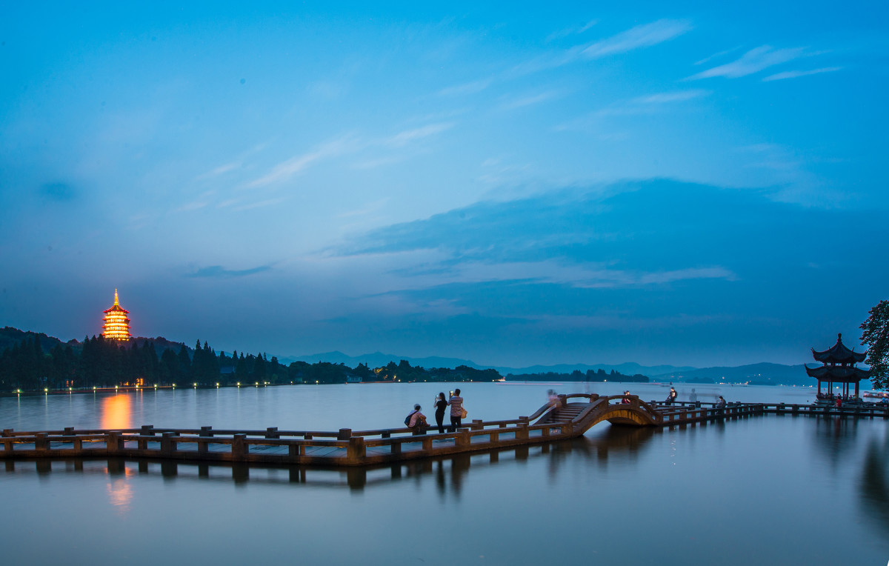


Introduction
West lake,
located to the west of hangzhou, zhejiang province, is one of the first national key scenic spots and one of the top 10 scenic spots in China.It's worth a visit.

Slide 11
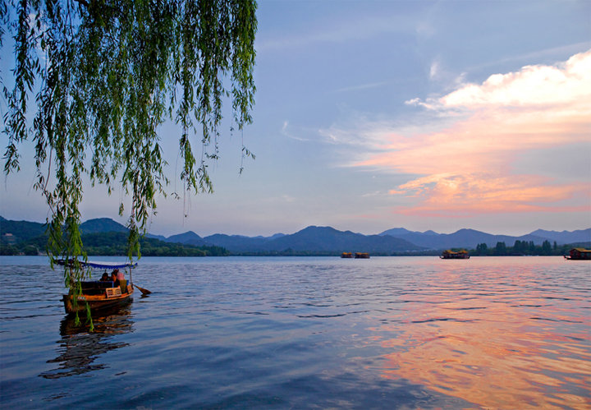
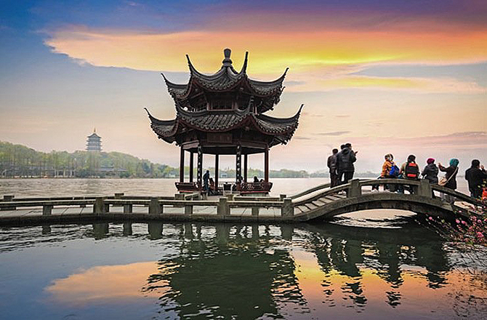
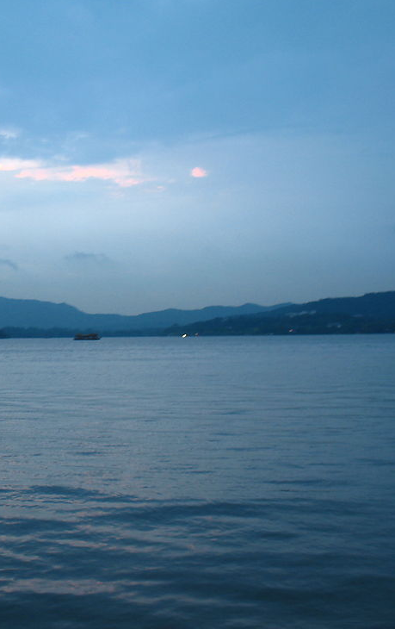
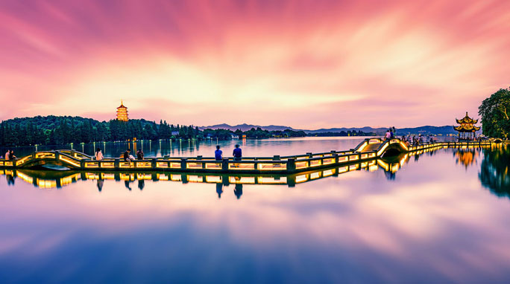
Beauty show

Slide 12
Funny
My Trip
Moment

Slide 13
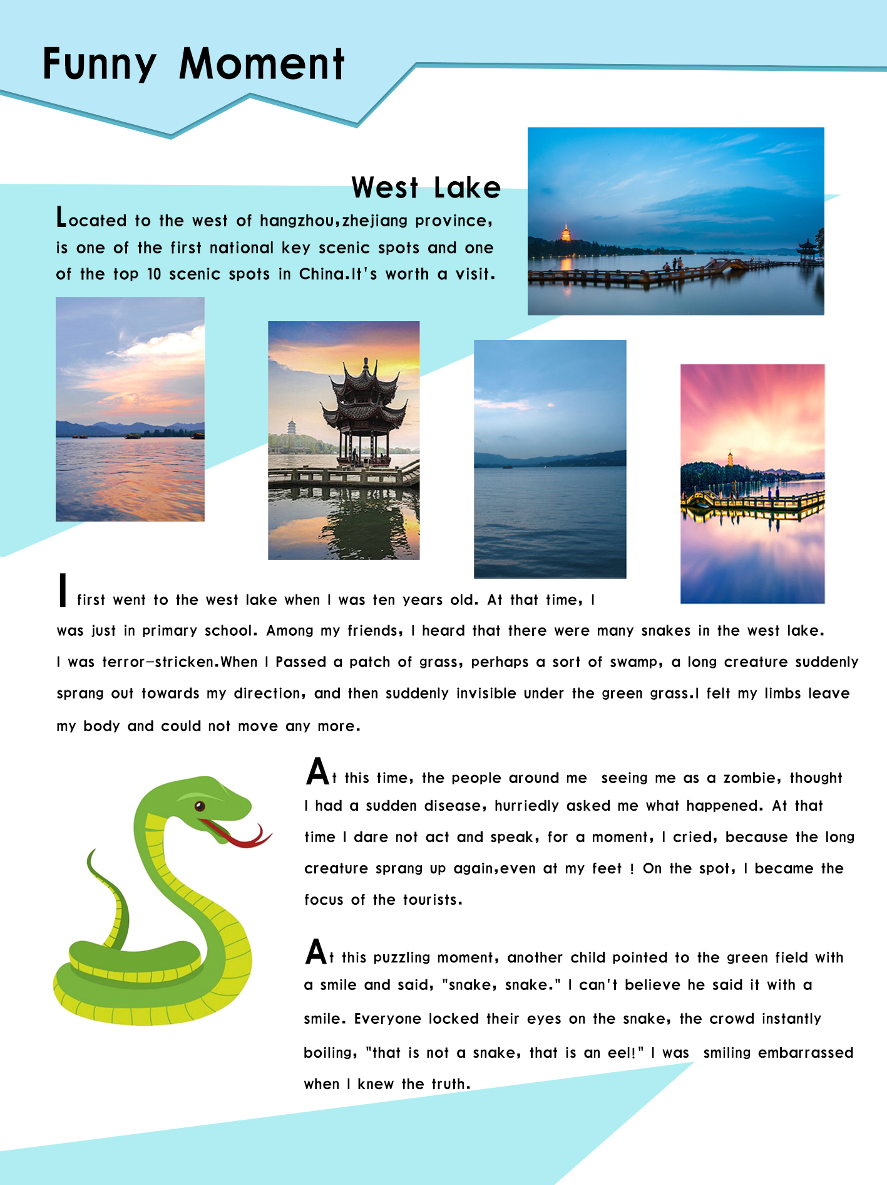


My Magzine Page

Slide 14

Funny Moment
I first went to the west lake when I was ten years old. At that time, I was just in primary school. Among my friends, I heard that there were many snakes in the west lake. I was terror-stricken.When I passed a plain patch of grass, perhaps a sort of swamp, a long creature suddenly sprang out towards my direction, and then suddenly invisible under the green grass.I felt my limbs leave my body and could not move any more.

Slide 15
Funny Moment
At this time, the people around me seeing me as a zombie, thought I had a sudden disease, hurriedly asked me what happened. At that time I dare not act and speak, for a moment, I cried, because the long creature sprang up again,even at my feet ! On the spot, I became the focus of the tourists.

Slide 16

Funny Moment
At this puzzling moment, another child pointed to the green field with a smile and said, "snake, snake." I can't believe he said it with a smile. Everyone locked their eyes on the snake, the crowd instantly boiling, "that is not a snake, that is an eel!" I was smiling embarrassed when I knew the truth.

Slide 17
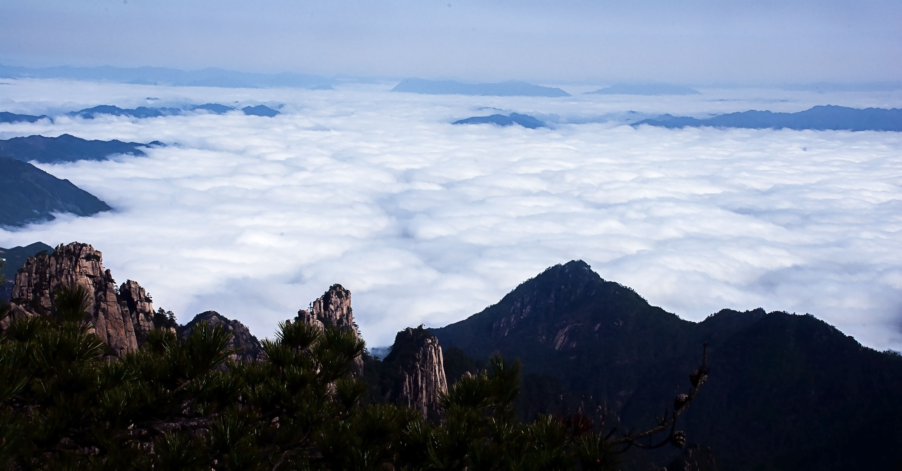
Best in My Eyes
—Huangshan
—Group 4

Slide 18
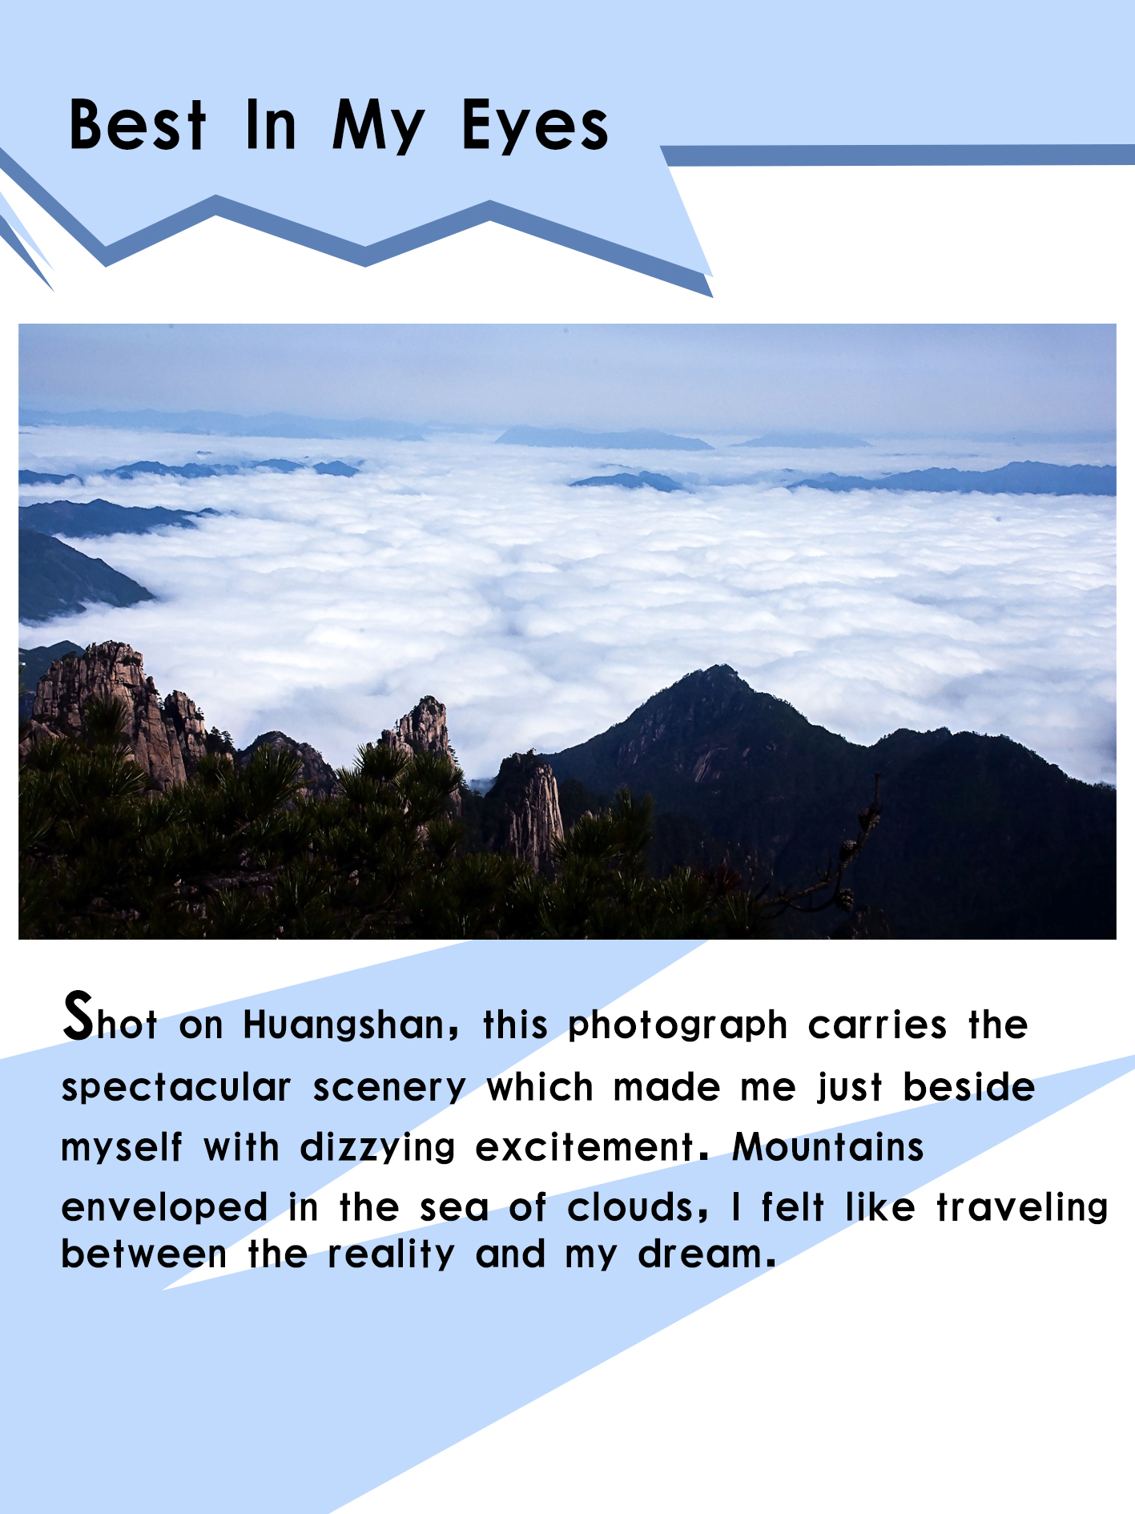
My Magzine Page

Slide 19
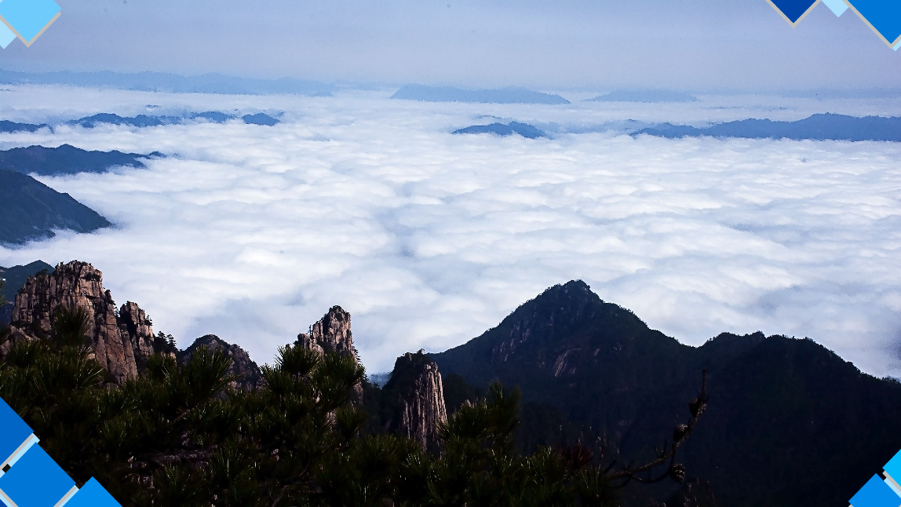
Shot on Huangshan,
this photograph carries the spectacular scenery which made me just beside myself with dizzying excitement. Mountains enveloped in the sea of clouds, I felt like traveling between the reality and my dream.

Slide 20
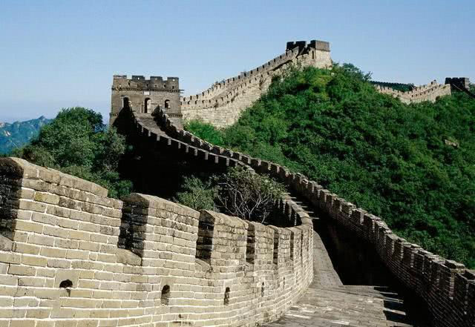
—The Great Wall
Recommendation
—Group 4

Slide 21
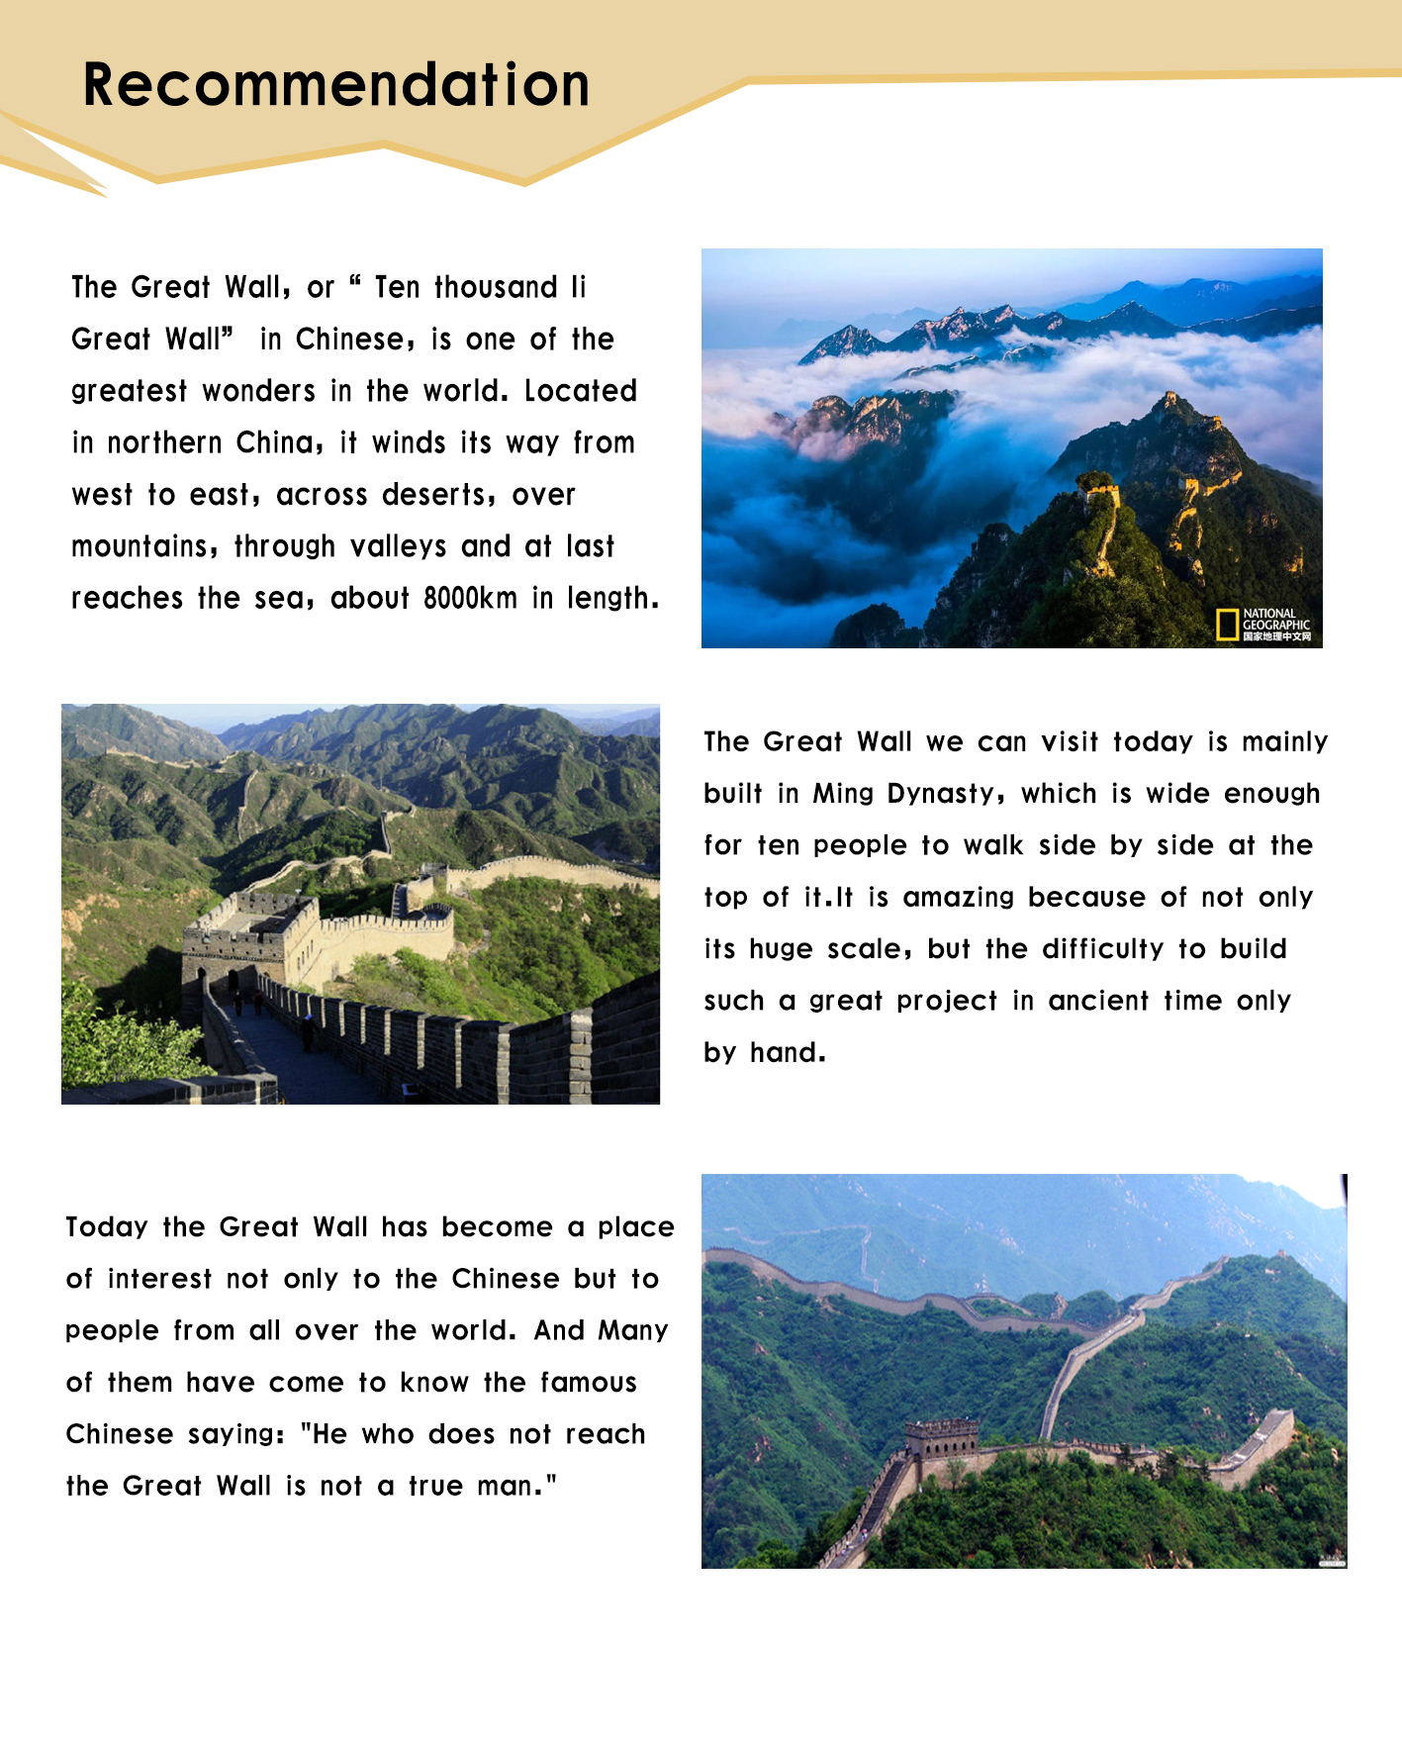
My Magzine Page

Slide 22
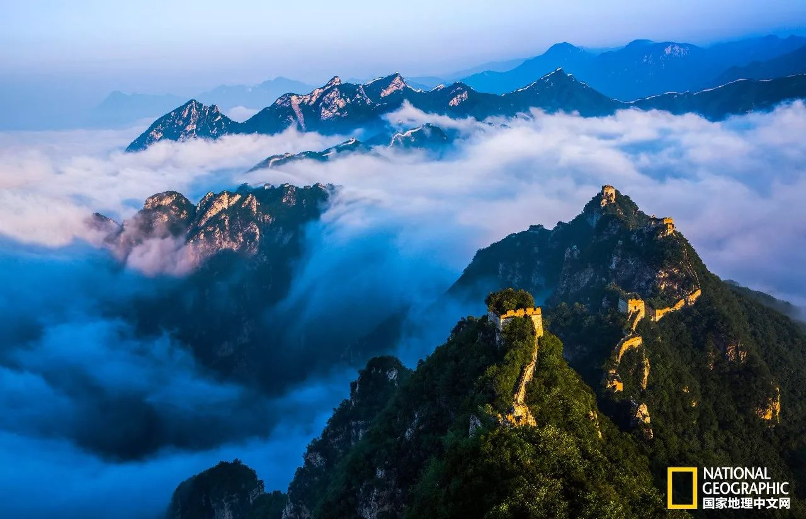
The Great Wall,
or“ Ten thousand Ii Great Wall” in Chinese, is one of the greatest wonders in the world. Located in northern China, it winds its way from west to east, across deserts, over mountains, through plains and at last reaches the sea, about 8000km in length.

Slide 23
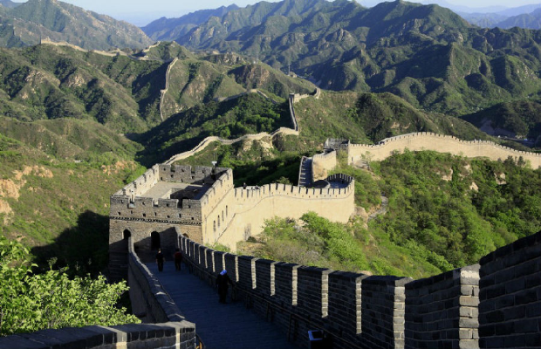
The Great Wall we can visit today is mainly built in Ming Dynasty, build to defend the border. Although it looks slender, acutally it is wide enough for ten people to walk side by side at the top of it. It is amazing because of not only its huge scale, but the difficulty to forge such a great project in ancient time only by hand.

Slide 24
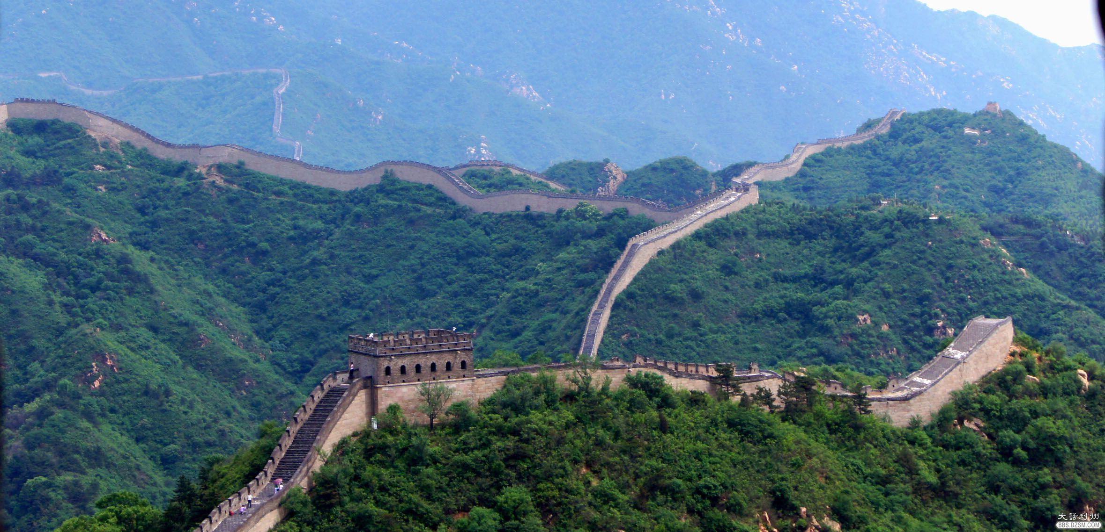
Today the Great Wall has become a place of interest not only to the Chinese but to people from all over the world. And Many of them have come to know the famous Chinese saying: "He who does not reach the Great Wall is not a true man."

Slide 25
plain: adj.清楚的; 明显的; 浅白的; 坦诚的; 直率的; 直接的; 不尚修饰的; 朴素的;
n. 平原
defend: v. 防御; 保护; 保卫; 辩解; 辩白; 防守;
slender: adj. 苗条的; 纤细的; 细的; 窄的; 微薄的; 不足的
scale: n. (尤指与其他事物相比较时的) 规模，范围，程度; 等级; 级别; 等级体系
v.攀登; 到达…顶点; 去鳞; 刮除牙石
forge: v. 艰苦干成; 努力加强; 伪造; 假冒; 锻造; 制作
n.铁匠铺; 锻铁炉; 锻造车间; 锻造工厂

Slide 26
Thanks for
watching

